Slide 1
STC Data Summit 2025
Sociology, Anthropology, Social Work

Slide 2
About
In preparation for this year’s data summit, RAS created data sets that would be analyzed with Microsoft PowerBI. Access was given to chairs with the note that instructors would not be given access to the platform in order to avoid the potential of crashing the data set. To prepare for the summit, chairs were requested to pull out any necessary information that may help with summit activities and goals, as well as information centering on course success
The following presentation has information on:
Course Success Rates (per college requests)
Other Course Success Data (pulled out based on trends)
Other institutional Data (pulled out based on trends)
Want more data? Send Rolo an email with request.

Slide 3
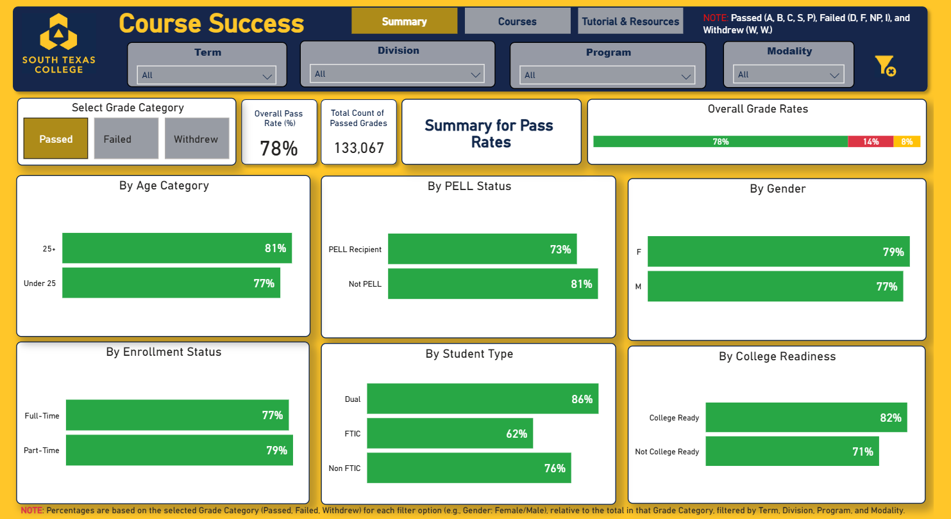
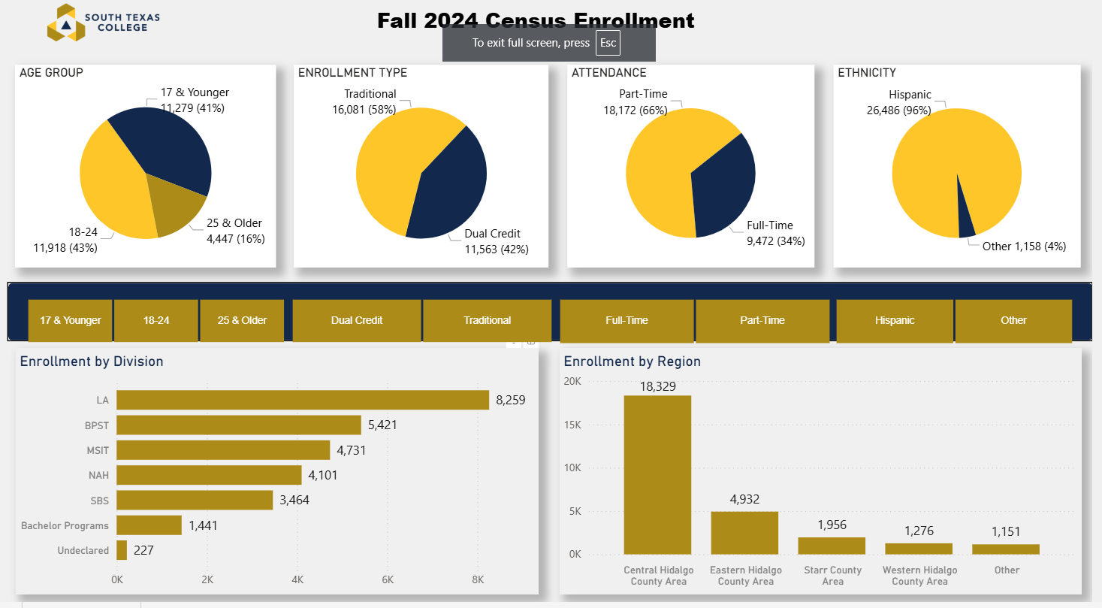
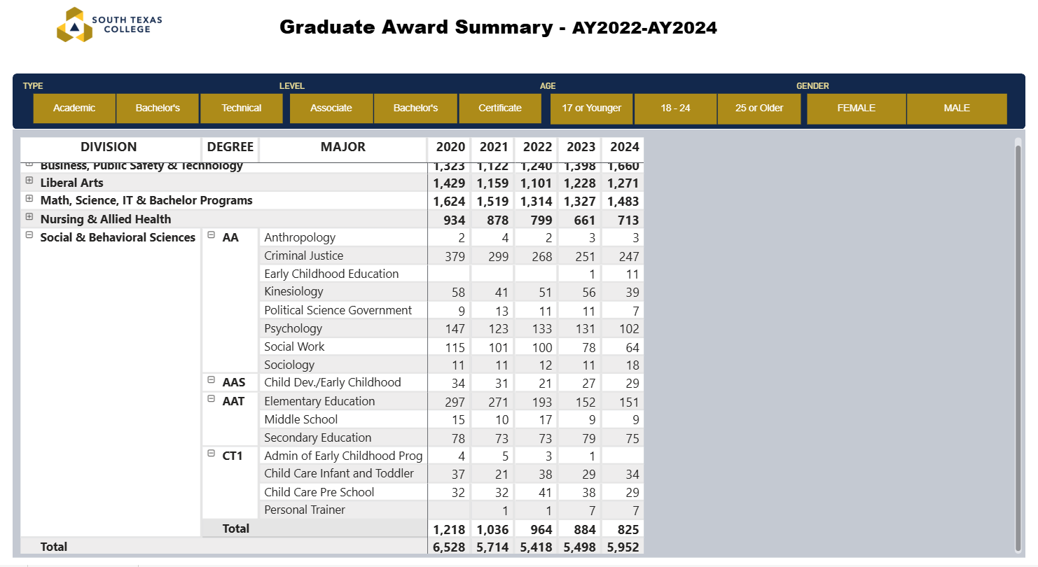
Dashboards
Three dashboards for data exist:
Course Success
Enrollment Metrics
Graduate Awards Metrics

Slide 4
Institutional Data
 | STC Average | SOCI | ANTH | SOCW
Pass | 78% | 85% | 91% | 80%
Fail | 14% | 10% | 6% | 10%
Withdraw | 8% | 5% | 3% | 10%

Slide 5
Sociology Data
 | Student Group | Pass Rate
STC Highest Pass Rate | Dual Credit | 86%
SOCI Highest Pass Rate | Women Dual College Ready | 87%
STC Lowest Pass Rate | FTIC (1st time in college) | 62%
SOCI Lowest Pass Rate | FTIC (1st Time in college) | 71%
Face to Face Pass Rate |  | 88%
Online Pass Rate |  | 81%
CBE Pass Rate |  | 88%
Hybrid Pass Rate |  | 79%
OTHER DATA:
Highest Enrollment – SOCI 1301
Pass Rate: 86%
Notable Data
Student Demographics:
Not College Ready Pass rate 81%
First Time in College Pass rate 77%
Differences in Modality:
CBE has no drops
Hybrid pass rate 77%
Online Pass Rate 83%
Other Data:
CBE Full-Time Students Pass Rate 92%
Face to Face Not College Ready; 83% pass rate, 11% fail rate
First Time in College, 79% pass rate, 17% fail rate
Class with Highest Fail Rate: SOCI 1306 (18%)
 | STC Average | SOCI
Pass | 78% | 85%
Fail | 14% | 10%
Withdraw | 8% | 5%

Slide 6
Anthropology Data
 | Student Group | Pass Rate
STC Highest Pass Rate | Dual Credit | 86%
ANTH Highest Pass Rate | Dual Credit | 96%
STC Lowest Pass Rate | FTIC (1st time in college) | 62%
ANTH Lowest Pass Rate | FTIC (1st Time in college) | 73%
Face to Face Pass Rate |  | 92%
Online Pass Rate |  | 90%
CBE Pass Rate
Hybrid Pass Rate
OTHER DATA:
Highest Enrollment – ANTH 2301
Pass Rate: 87%
Notable Data
Student Demographics:
25+ (Age) Fail Rate 12%, Withdraw 9%
Not College Ready Fail Rate 18%
No failures in Pell Grant category
Differences in Modality:
Full Time Failure Rate 0%, Withdraw Rate 5%
Part Time Failure Rate 5%, Withdraw 3%
Other Data:
Class with Highest Fail Rate: ANTH 2301 (10%)
 | STC Average | ANTH
Pass | 78% | 91%
Fail | 14% | 6%
Withdraw | 8% | 3%

Slide 7
Social Work Data
 | Student Group | Pass Rate
STC Highest Pass Rate | Dual Credit | 86%
SOCW Highest Pass Rate | Part Time College Read | 85%
STC Lowest Pass Rate | FTIC (1st time in college) | 62%
SOCW Lowest Pass Rate | FTIC (1st Time in college) | 45%
Face to Face Pass Rate |  | 74%
Online Pass Rate |  | 81%
CBE Pass Rate
Hybrid Pass Rate |  | 86%
OTHER DATA:
Highest Enrollment – SOCW 2361
Pass Rate: 77%
Notable Data
Student Demographics:
Full-Time Students have a slightly lower pass rate (72%)
College ready students have a pass rate of 81%; Non-College Ready have a pass rate of 68% and a fail rate of 20%
Differences in Modality:
Withdraw rate is higher in face-to-face classes (25%)
Hybrid pass rate is high with no withdrawals
Face-to-face students over 25 are more likely to withdraw (40%) versus those under 25 (19%)
Online Not College Ready students have a lower pass rate (68% vs. overall rate of 77%)
Other Data:
Class with Highest Fail Rate: SOCW 2361 (12%)
 | STC Average | ANTH
Pass | 78% | 91%
Fail | 14% | 6%
Withdraw | 8% | 3%

